Slide 1
Version Control
…using Git/Tortoise Git
By CP

Slide 2
What is Version Control?
“A system that records changes to a file or set of files over time so that you can recall specific versions later”
Works for *ANY* file type
A Time machine for your files

Slide 3

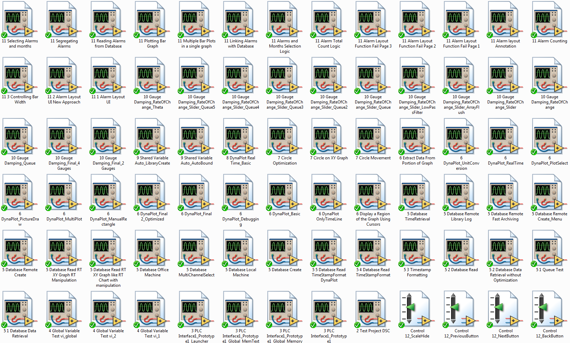
Why Version Control?
Version Control saves lives!

Slide 4
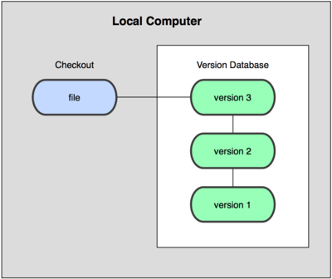
Version Control Types
Local Version Control System

Slide 5
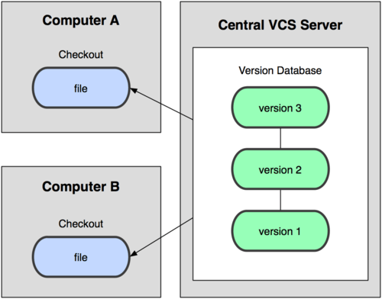
Version Control Types
Centralized Version Control Systems

Slide 6
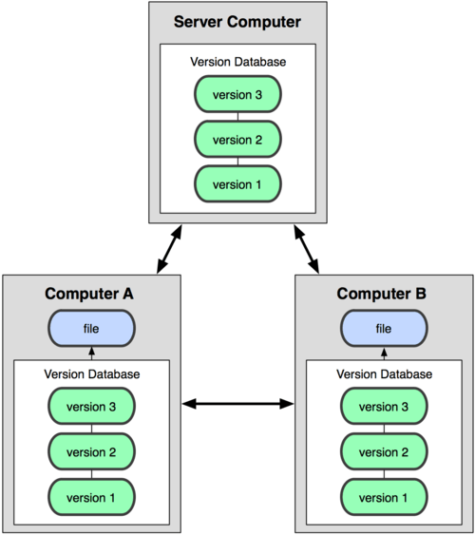
Version Control Types
Distributed Version Control Systems
  Fully mirrored repository for each client
  Best Crash protection possible
Git

Slide 7
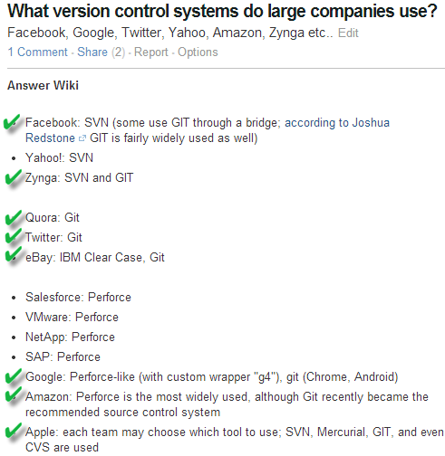

Q: Who uses Git?
A: Everyone.

Slide 8



Q: Who wrote Git?
A: God.

Slide 9
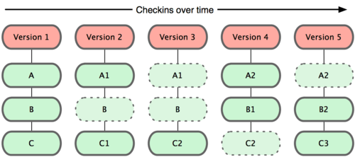
How does it work?
You: Files files files; Git: Snapshot!
Every ‘commit’ is saving the state of your project
  A snapshot of how the files look like at that moment and stores a ‘reference’ to that snapshot
  File is stored ONLY if it has changed

Slide 10
How does it work?
All operations happen locally
  No need for a network as long as you are coding on your own (though, you can’t collaborate without it)
EVERYTHING is check summed
  Impossible to change the contents of any file or directory without Git knowing about it
  We’ll know if you crashed the build!
Once you have committed, you CAN’T go back or delete
  Git believes in the true meaning of the word ‘commit’

Slide 11
The Three States of Git
Modified
  File has been changed, but not committed to the local database yet
Staged
  File has been ‘marked’ in its current version to go into the next commit snapshot
Committed
  Data is safely stored in your local database

Slide 12
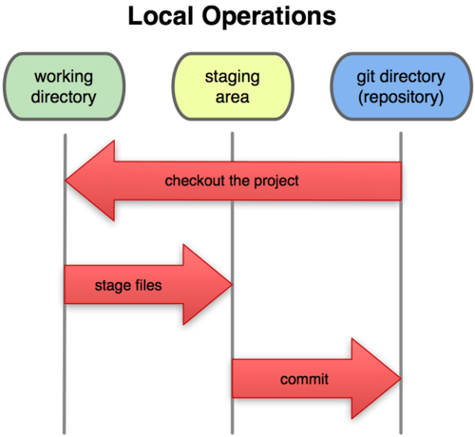
The Three States of Git
Staging Area
  It’s a file that stores information about what will go into the next commit
  Also referred to as the ‘index’

Slide 13
Hence, the simplified workflow…
Clone a repository from the cloud :ONLY ONCE:
Modify/Change, add new files in the working directory
‘Stage’ the files, adding snapshots of them to the staging area
Make a ‘commit’. This takes the files as they are in the staging area and stores that snapshot permanently in the local Git directory
‘Push’ the changes back to the cloud

Slide 14
Get Git
Please install in the following sequence
The Git (default settings)
  https://code.google.com/p/msysgit/downloads/list
Interface for Humans – Tortoise Git
  https://code.google.com/p/tortoisegit/wiki/Download
Cloud
  https://bitbucket.org/
  ONLY REGISTER from my invitation

Slide 15
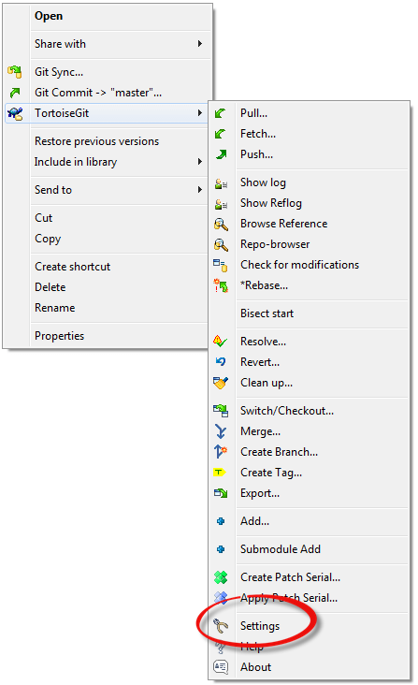
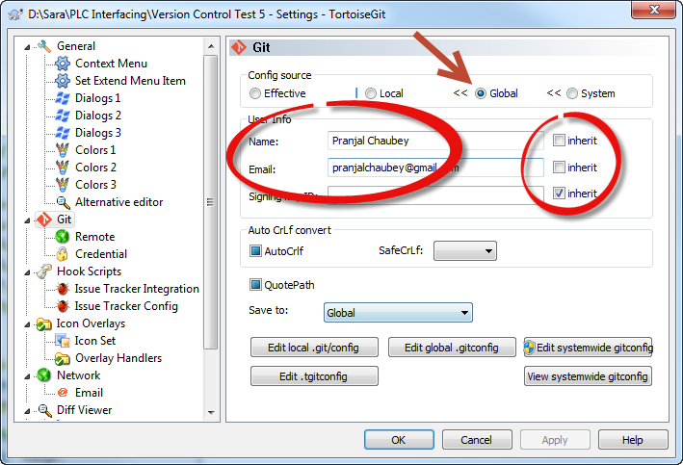
Setup Git
Tell Git who you are…..

Slide 16
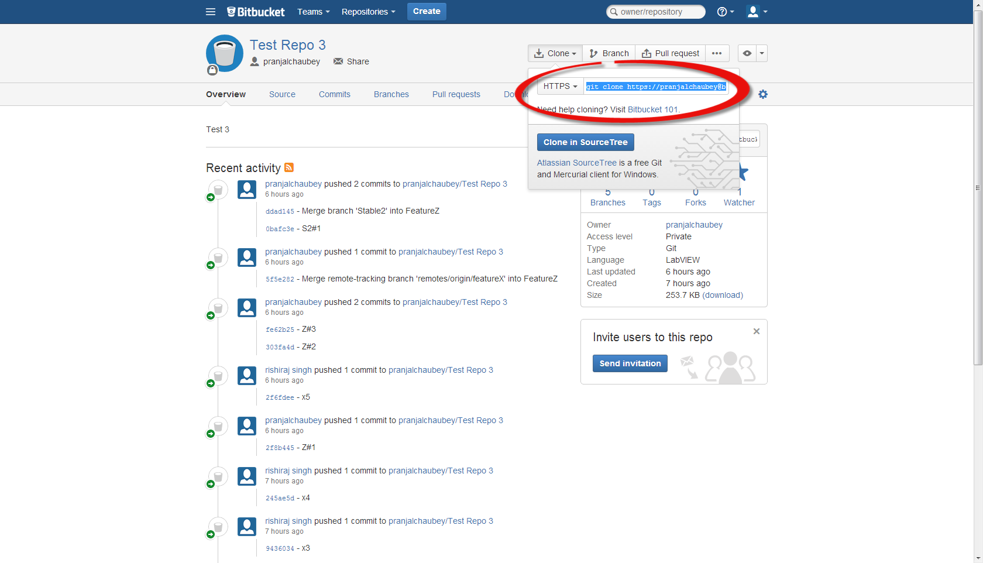
Setup Git
Tell Git where the cloud repository is….

Slide 17
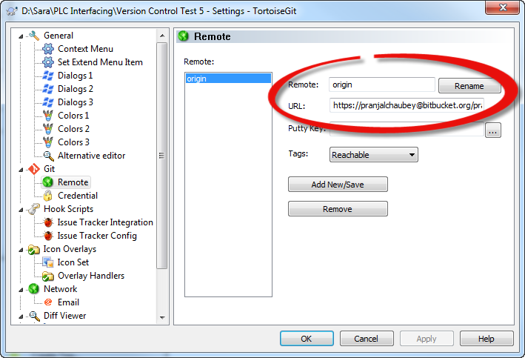
Setup Git
Tell Git where the cloud repository is….

Slide 18
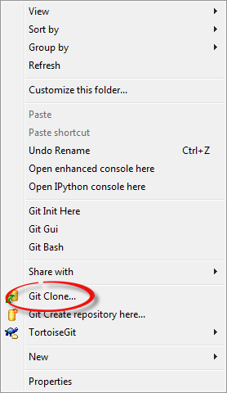
Setup Git
‘Clone’ it!

Slide 19
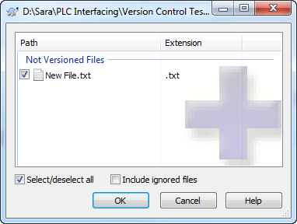
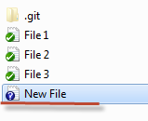

Working with Git
Once the repository in the cloud has been ‘cloned’, you can make changes/modifications/add files
In case you add new files, inform Git about them by using the ‘Add’ command

Slide 20
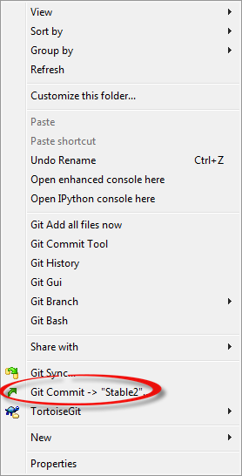
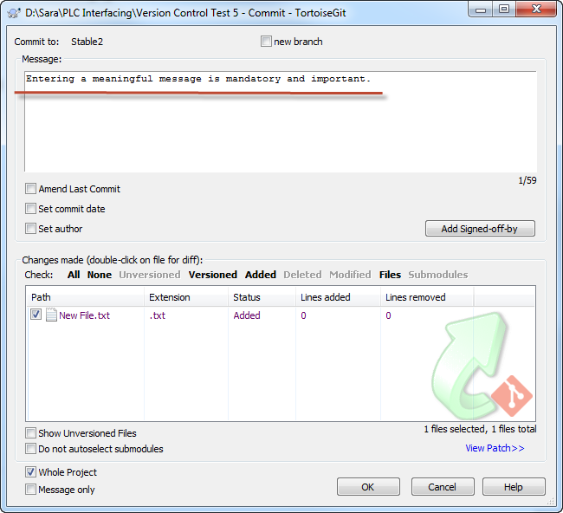
Working with Git
Once you are done, Commit!

Slide 21
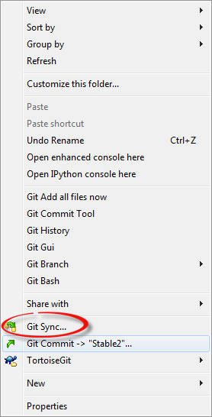
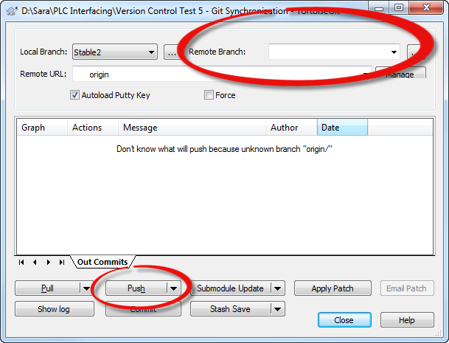
Working with Git
‘Push’ changes back into the cloud

Slide 22
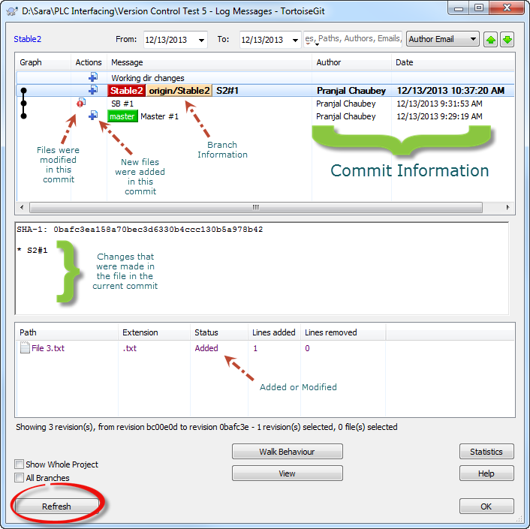
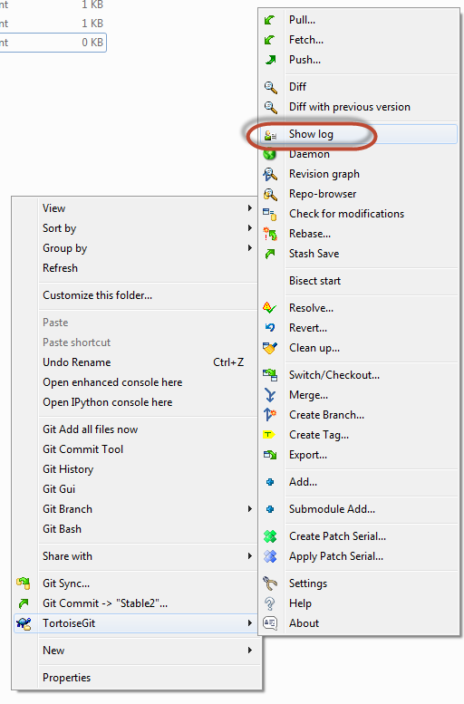
Working with Git
‘History’ of snapshots

Slide 23
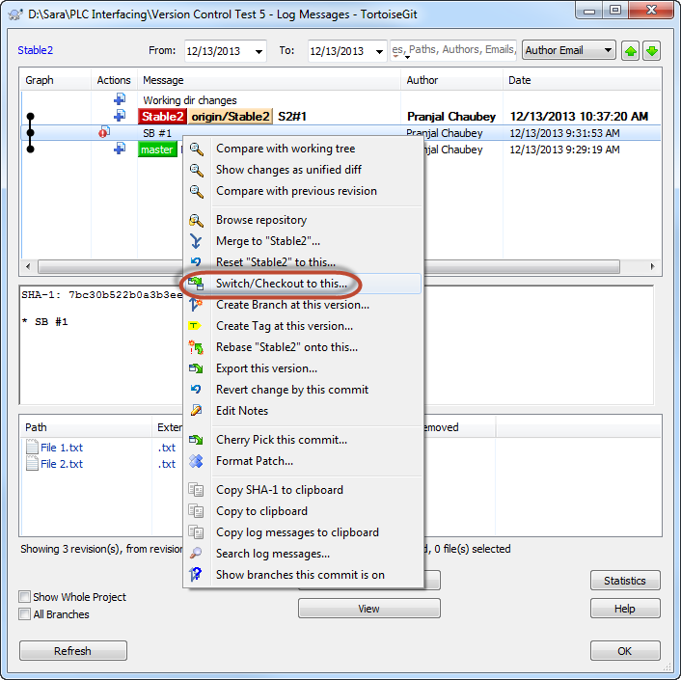
Working with Git
Git, The Time Machine

Slide 24
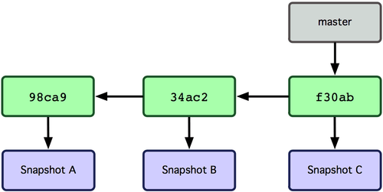
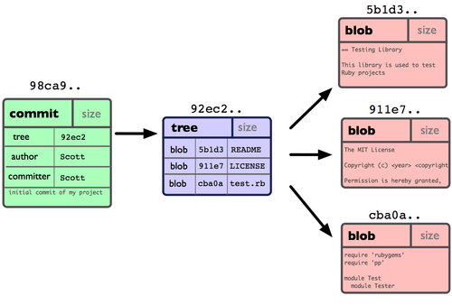
Branching
Divide and rule!

Slide 25
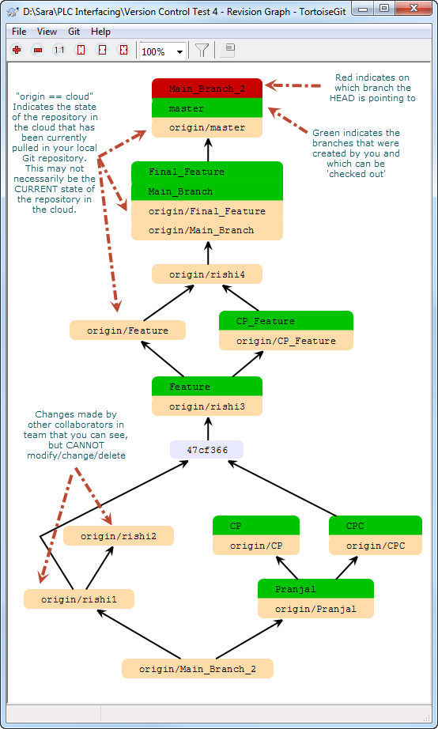
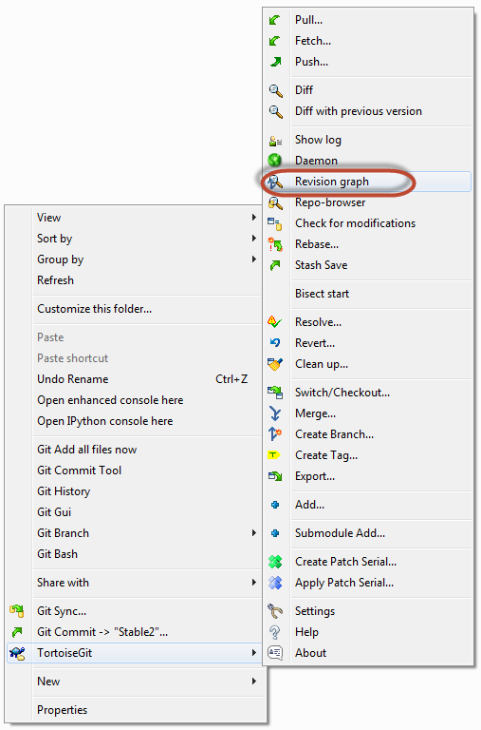
Branching
Revision Graph is a great tool ton visualize branching in Git

Slide 26
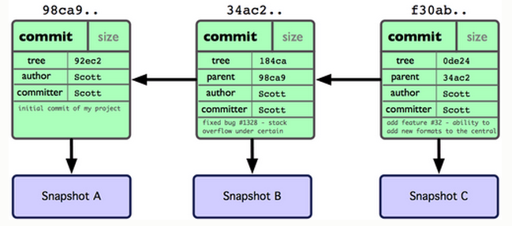
Branching
When you commit in Git, Git stores a commit object that contains a pointer to the snapshot of the content you staged, the author and message metadata, and zero or more pointers to the commit or commits that were the direct parents of this commit: zero parents for the first commit, one parent for a normal commit, and multiple parents for a commit that results from a merge of two or more branches.

Slide 27
Branching
A branch in Git is simply a lightweight movable pointer to one of the commits. The default branch name in Git is ‘master’. As you initially make commits, you’re given a master branch that points to the last commit you made. Every time you commit, it moves forward automatically.

Slide 28
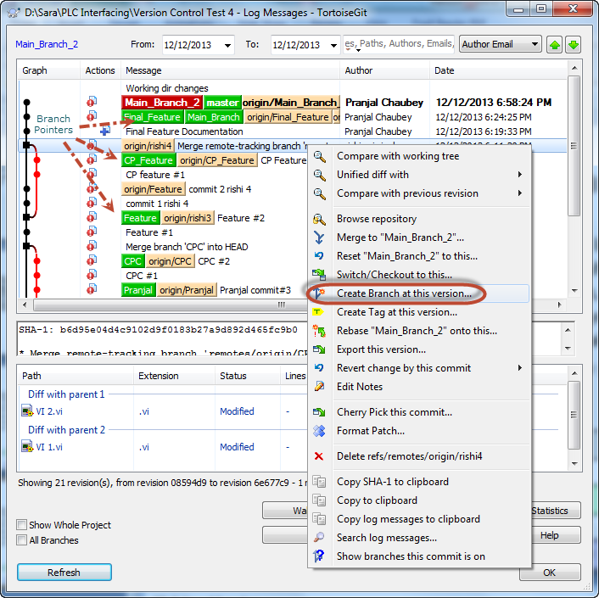
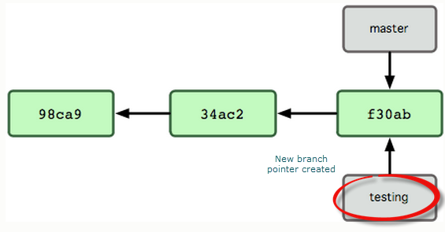
Branching
Creating a branch
New branch creates a new pointer for the user to move around.

Slide 29
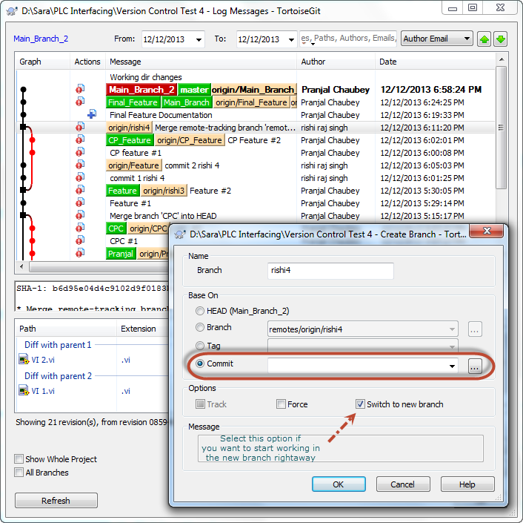
Branching
Creating a branch

Slide 30
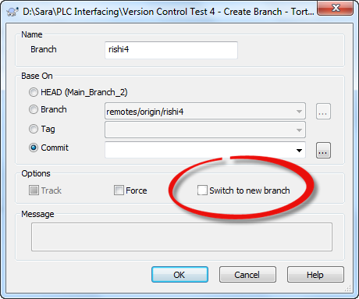
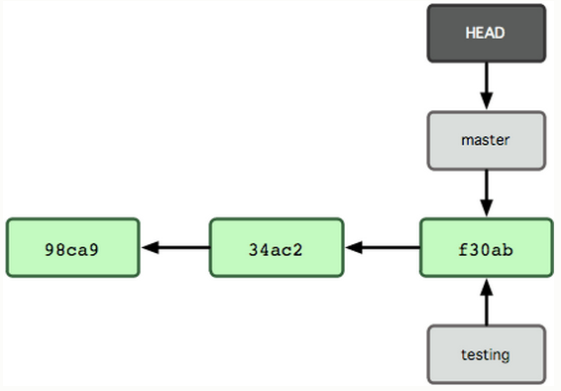
Branching
HEAD: Pointer to the local branch the user is currently on
Git uses HEAD to keep a track of where the user is
When Git creates a new branch, it doesn’t automatically switches to it unless otherwise stated

Slide 31
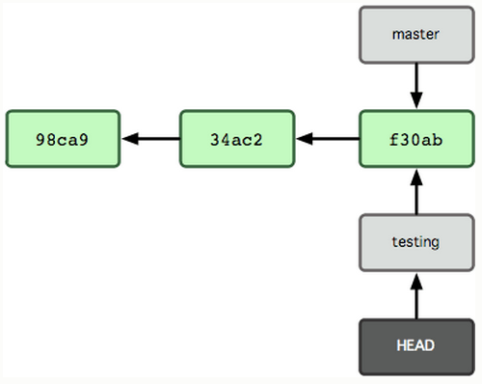
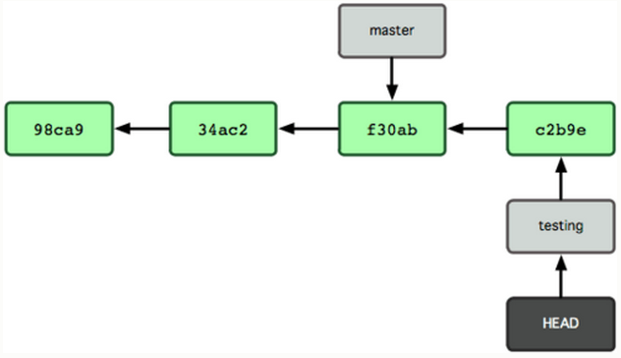
Branching
Switching the HEAD to the new branch and making a commit

Slide 32
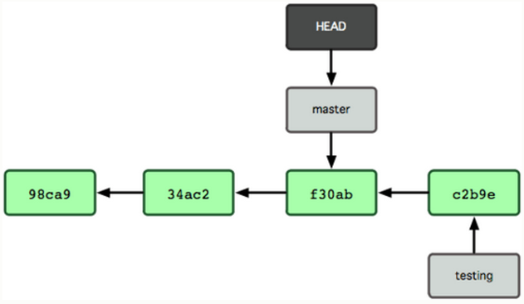
Branching
Now if you ‘checkout’ the ‘master’ branch, Git moves the HEAD back to the master + rewinds the files in the working directory to the snapshot that ‘master’ points to

Slide 33
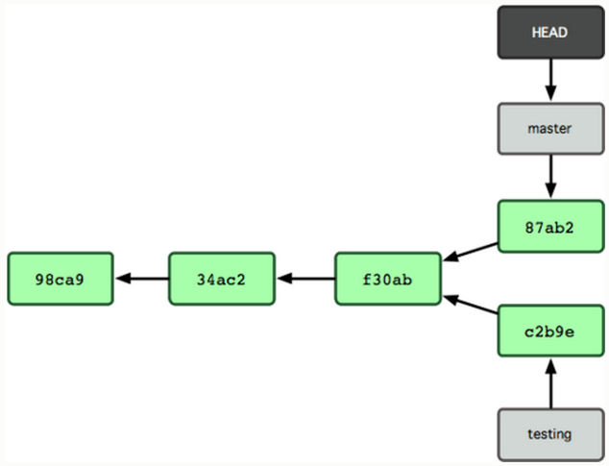
Branching
If you make a few more commits in the ‘master’ branch, the project history will diverge
Typically,
  Branch off from parent branch to work on a feature
  Make a few commits
  Once the feature is finalized, ‘Merge’ it with your parent branch

Slide 34
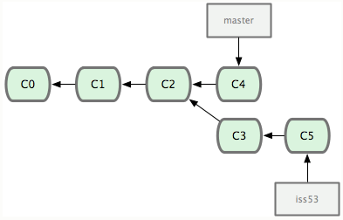
Branching
Merging
  Current state of the project
  You want to merge C4 and C5 snapshots

Slide 35
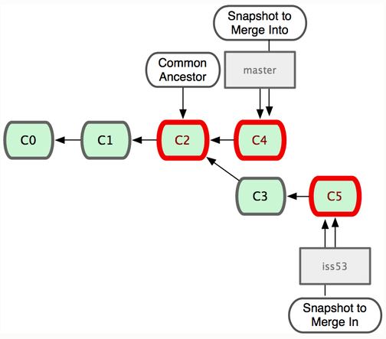
Branching
Merging
  Because the commit on the branch you’re on isn’t a direct ancestor of the branch you’re merging in, Git does a simple three-way merge, using the two snapshots pointed to by the branch tips and the common ancestor of the two.
  Instead of just moving the branch pointer forward, Git creates a new snapshot that results from this three-way merge and automatically creates a new commit that points to it. This is referred to as a ‘merge commit’ and is special in that it has more than one parent.

Slide 36
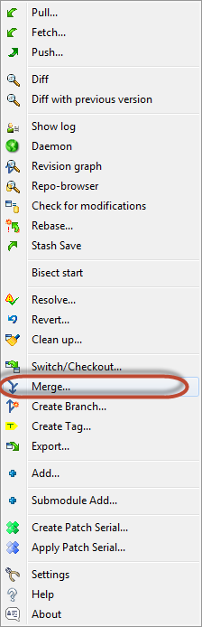
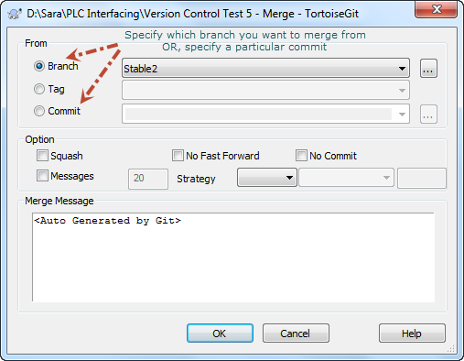
Branching
Merging

Slide 37
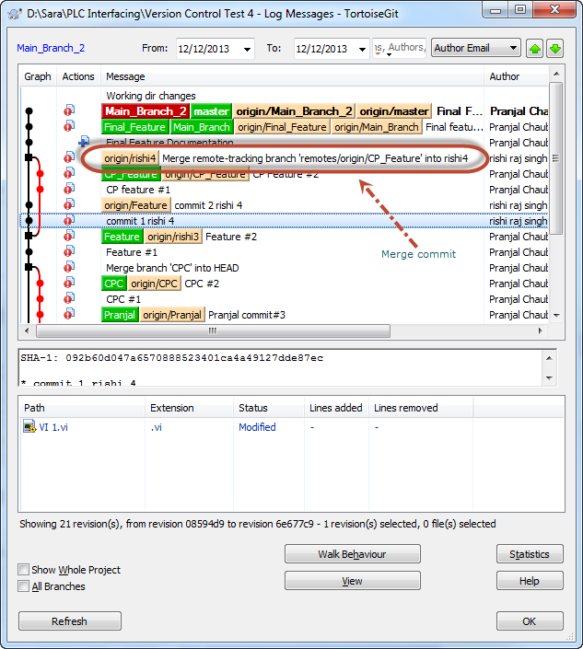
Branching
Merging
  Merge Commit

Slide 38
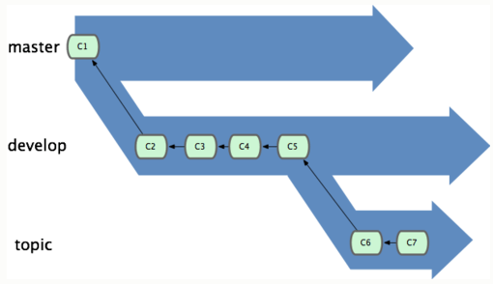
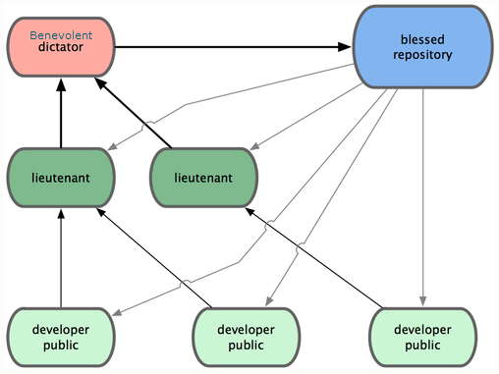
Branching
Branching Workflows

Slide 39
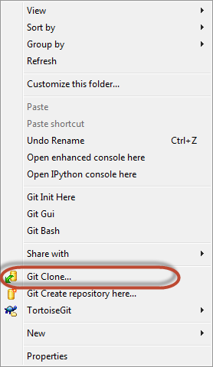
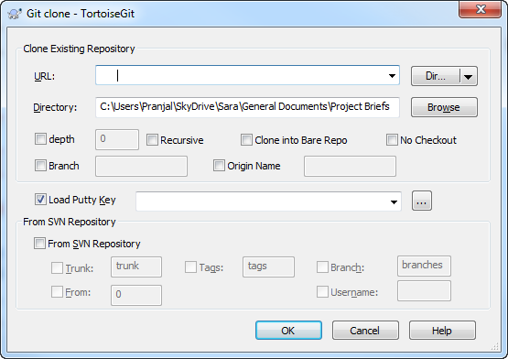
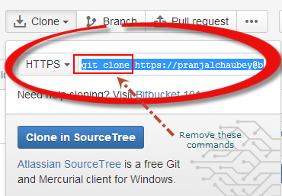
Working with Remote Repository
‘Clone’ repository from the cloud
Make commits, create branches

Slide 40
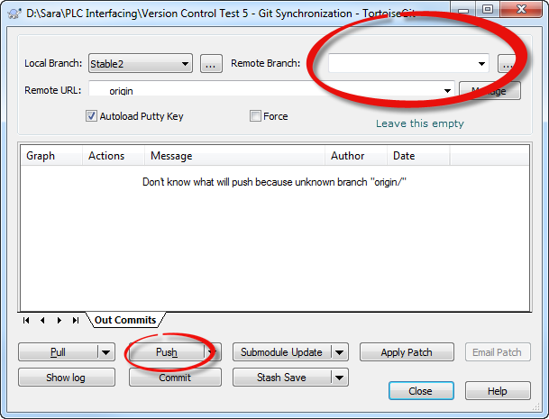
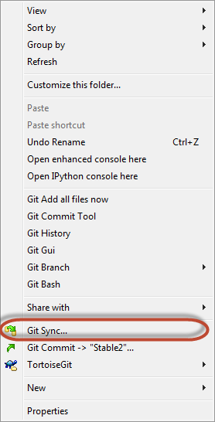
Working with Remote Repository
‘Push’ your local repository on the cloud

Slide 41
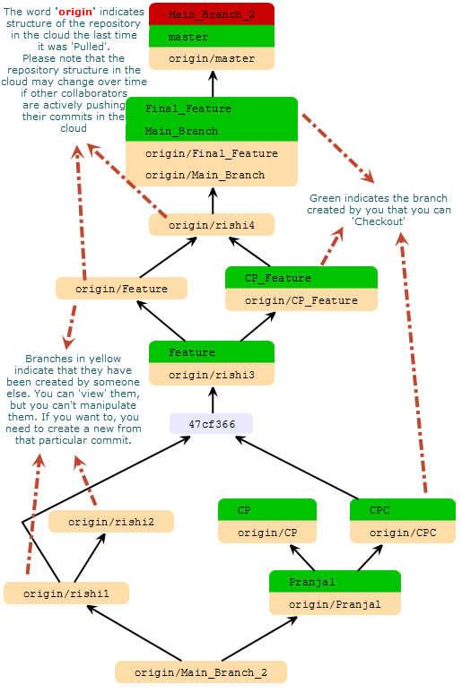
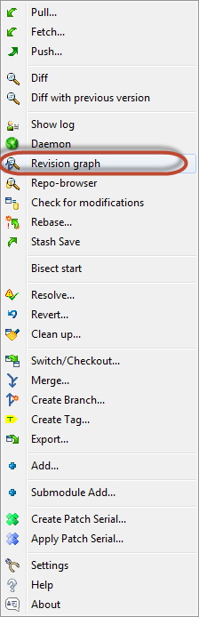
Working with Remote Repository
Checking out the structure of your local repository
One of the features of Git is that you cannot modify a branch created by a fellow collaborator. If you need to, you have to create your own branch from that particular commit. This ensures that each collaborators’ code remains consistent from their perspective.

Slide 42
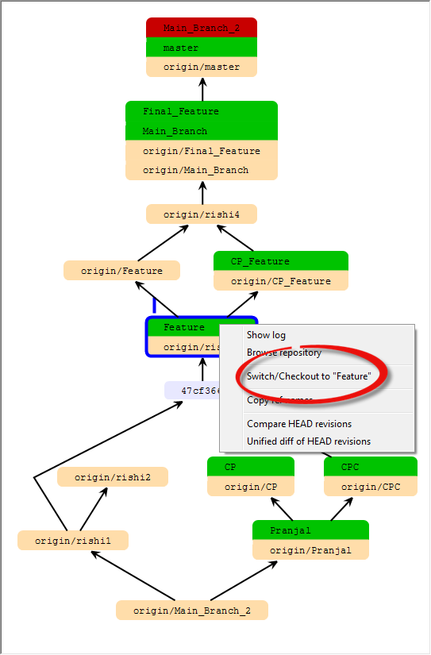
Working with Remote Repository
Moving around branches created by you

Slide 43


Working with Remote Repository
Moving around branches created by others

Slide 44

Working with Remote Repository
Moving around branches created by others

Slide 45


Working with Remote Repository
When others are collaborating, it might happen that the structure of the repository in the cloud might change while you are working on the local repository

Slide 46

Working with Remote Repository
To bring the latest repository image from the cloud to your local repository
  Do a ‘git fetch origin’

Slide 47

Working with Remote Repository
After updating the local repository from the cloud, the local repository will look like this

Slide 48


Working with Remote Repository
When creating branches to work on particular features, always create ‘Tags’ once the feature is finalized

Slide 49
Thank You!
Phew…..!
Stuff copied from http://git-scm.com/book

